Slide 1
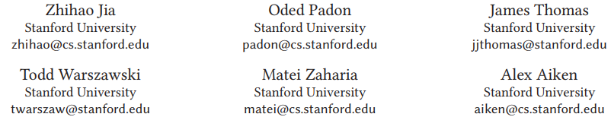
TASO: Optimizing Deep Learning Computation with Automatic Generation of Graph Substitutions [SOSP19]

Slide 2
Graph Substitutions
Definition
To replace a subgraph matching a specific pattern with a functionally equivalent subgraph with improved performance
The most commonly discussed concept, operator fusion/splitting are the subsets of Graph Substitutions
A graph substitution consists of three components
a source graph that is matched to subgraphs in the original computation graph
a target graph that defines a functionally equivalent new subgraph to replace the matched subgraph
a mapping relation describe the relation between input/output tensors in the source and target graphs

Slide 3
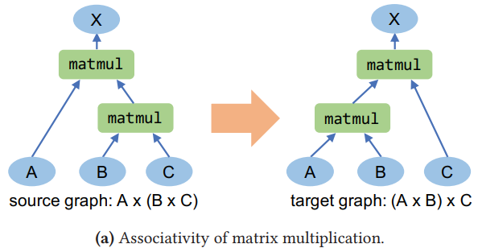
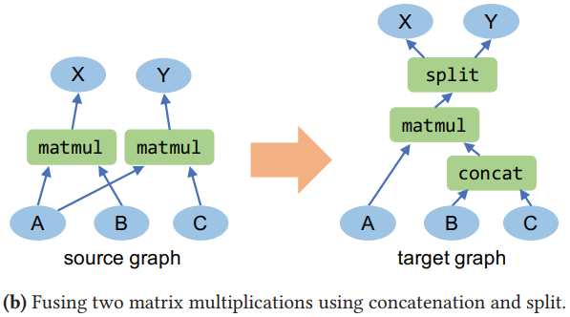
Graph Substitutions
Examples

Slide 4
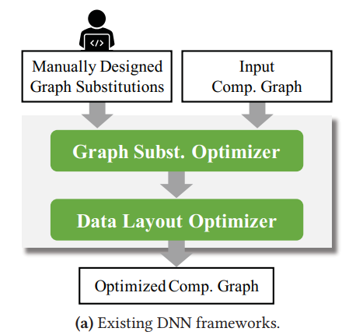
Related Work
Existing DNN frameworks optimize a computation graph by applying graph substitutions that are manually designed by domain experts
TensorFlow, PyTorch, TensorRT, and TVM use a greedy rule-based optimization strategy and directly perform all applicable substitutions on the computation graph
MetaFlow constructs a large search space of equivalent computation graphs and uses back-tracking search to explore this space. Manually specified substitutions are still required.

Slide 5
Related Work
Problems of existing method
Maintainability:
TensorFlow r1.14 includes 155 substitutions implemented in approximately 53K lines of C++ code
New operators are continuously introduced
Data layout:
The data layout of tensor has a high impact on runtime performance.
A graph substitution may only improve performance if it is combined with a particular layout
Current frameworks treat data layout and graph substitution as separate optimization problems and solve them sequentially
Correctness:
Hand-written graph substitutions are error-prone (There are still many bugs in TF/Pytorch Now)
Formally verifying optimizations can be a promise solution, but they are not applied to this field

Slide 6
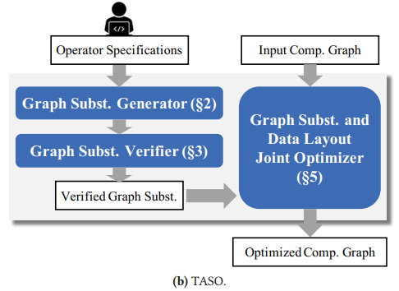
Overview
Graph Substitution Generator:
Enumerates all possible computation graphs over a given set of DNN operators up to a fixed size to find candidate substitution
Graph Substitution Verifier
Ensure the correctness of the generated graph substitutions relying on user provided operator properties
Joint Optimizer
Jointly optimizes graph substitutions and data layout transformations by integrating them into a common representation

Slide 7
Graph Substitution Generator
Step1: Enumerating potential graphs and collecting their fingerprints
Using DFS algorithm to construct all potential acyclic computation graphs up to a certain size by using a given set of operators
Compute the hash of the output tensors of each graph as the fingerprints
The size of input tensors are small for fast verification
All tensors are represented with integers to avoid floating-point errors
Two-step hash function is used to ensure the fingerprint is independent of any permutation of the output tensors
hash2 is a symmetric hash function applied to an unordered set of hash1 values.

Slide 8
Graph Substitution Generator
Step 2: Testing graphs with identical fingerprint
For graphs with the same fingerprint, examine their equivalence on a set of test cases
Using floating point numbers ranging between -1 and 1 in these test cases
Classifying two output tensors as equivalent if their outputs differ by no more than a small threshold value

Slide 9
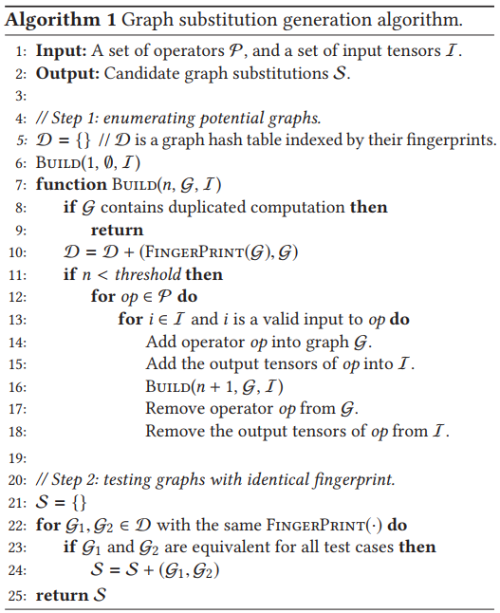
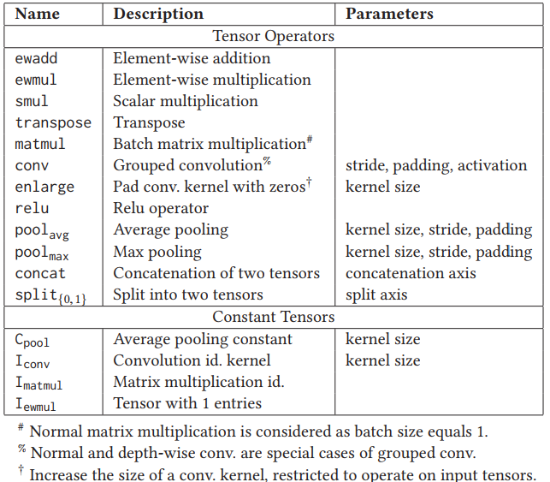
Graph Substitution Generator

Slide 10
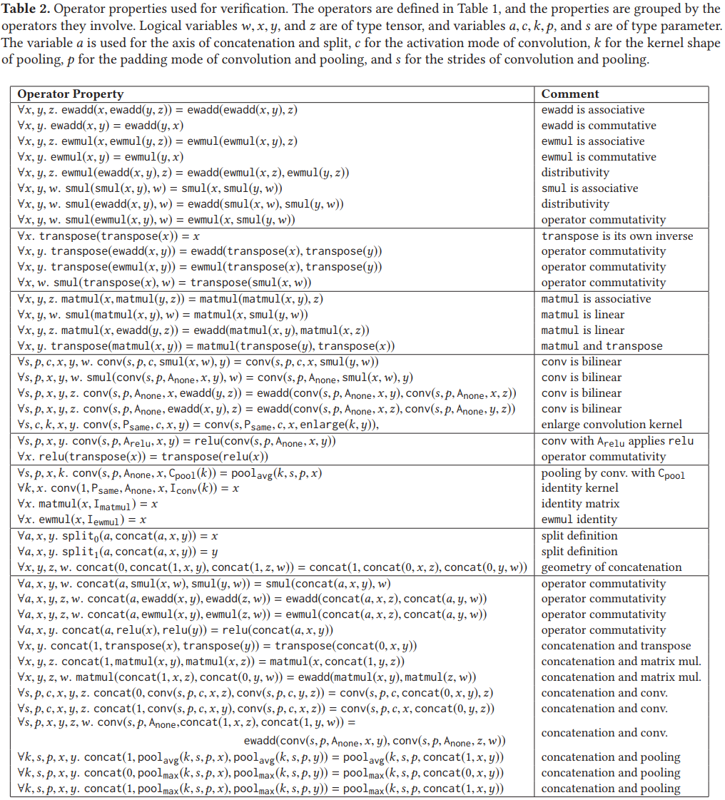


Graph Substitution Verifier
Using function to represent operators and their parameters and input tensors
Using a small set of operator properties expressed in first-order logic to formally verify substitutions
These properties are guided by the substitutions discovered by the substitution generator and then manually written
Using the entailment checking in first-order theorem to verify all generated substitutions

Slide 11
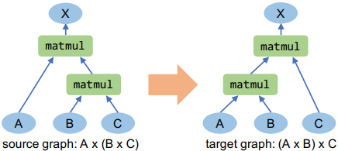
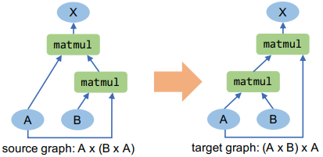
Pruning Redundant Substitutions
Definition: A graph substitution is redundant if it is subsumed by a more general valid substitution.
Input tensor renaming
Special case

Slide 12
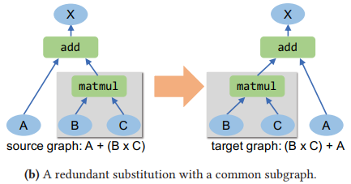
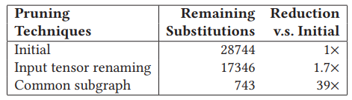
Pruning Redundant Substitutions (Optional)
Definition: A graph substitution is redundant if it is subsumed by a more general valid substitution.
Common subgraph
Eliminate substitutions whose source and target graphs have a common subgraph

Slide 13
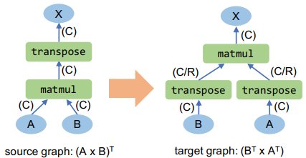
Joint Optimizer
Construct the cost model
Enumerates possible layouts for tensors in the target graph based on the data layouts of tensors in the source graph
Measures the execution time of a DNN operator once for each configuration and data layout
Estimates the performance of a graph by summing up the measured execution time of its operators

Slide 14
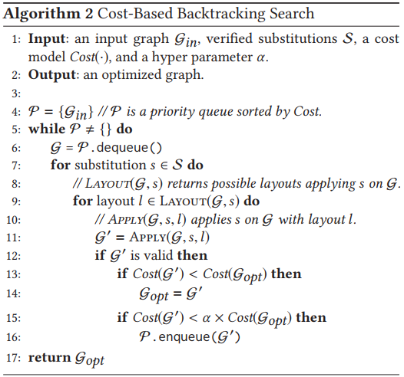
Joint Optimizer
Find the optimal solution
all candidate graphs are maintained in a priority queue P and are dequeued in increasing order of cost
graph substitutions can introduce cycles into a graph so the acyclicity of target graph should be checked
The search space is pruned by a hyper parameter α, which
directly eliminates all graphs whose cost is α times worse
than the best discovered graph.
Setting α = 1 reduces the search to a simple greedy algorithm
without backtracking

Slide 15
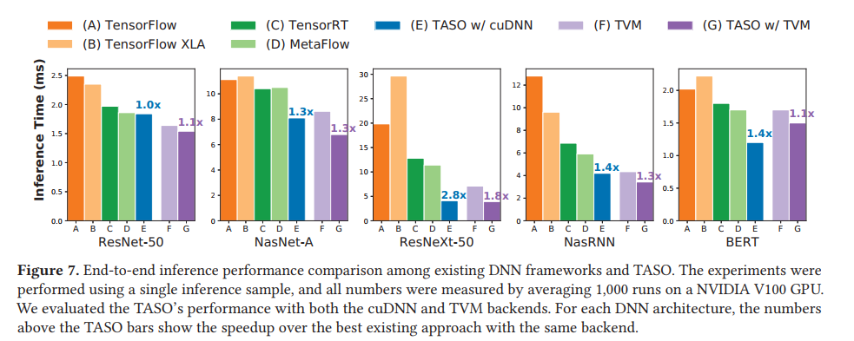
Experiments

Slide 16
Interesting place
Enumerate and Maintain a database of the graph substitution pairs of existing ops
Find the graph optimization rules automatically rather than manually
Problems
TASO does not use Tensor's size information to guide optimization, which may be important for the performance of a specific information
Cannot support complicate transformation

